Slide 1
PORTRAIT
MOBILE

Slide 2
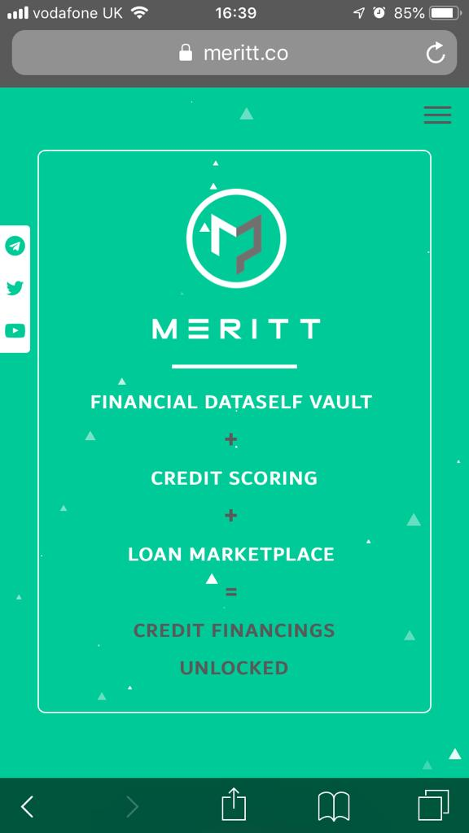
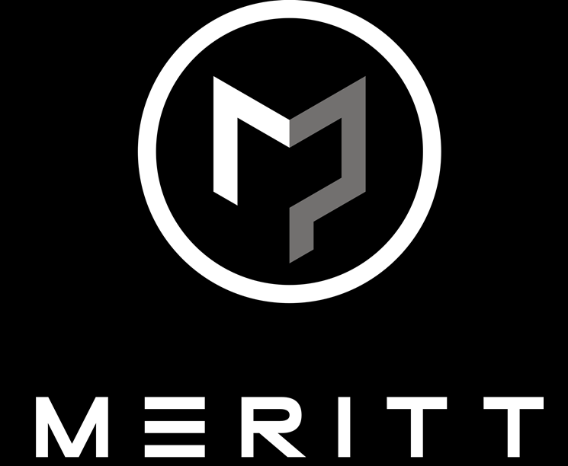
Existing
Revised
All
In
One
screen
ACCESS INSTANT UNSECURED LOANS¹
INVEST AT
SUPERIOR
RETURNS²
DIRECT LENDING PLATFORM
BIGDATASELF | A.I. SCORINGS | BLOCKCHAIN SERVICING
1:Borrow responsibly
2:Capital at risk
Login or join our whitelist

Slide 3
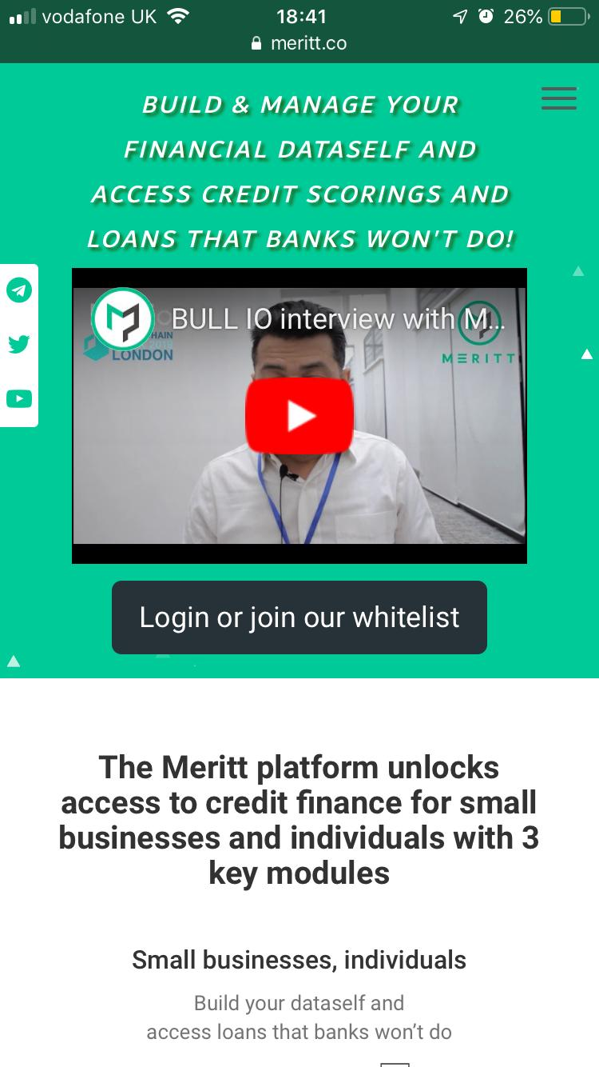
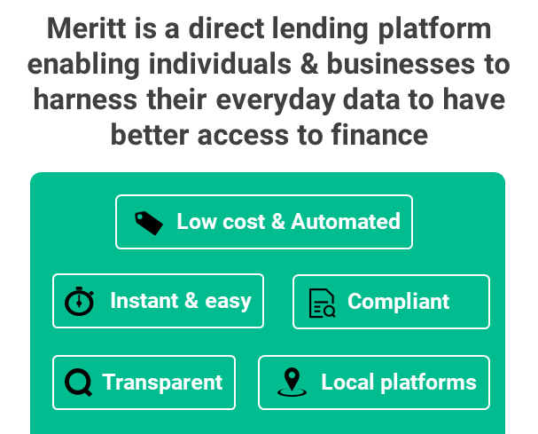
Existing
Revised
“BUILD & MANAGE YOUR
BIGDATASELF AND
ACCESS CREDIT SCORINGS AND LOANS THAT BANKS WON’T DO!”

Slide 4
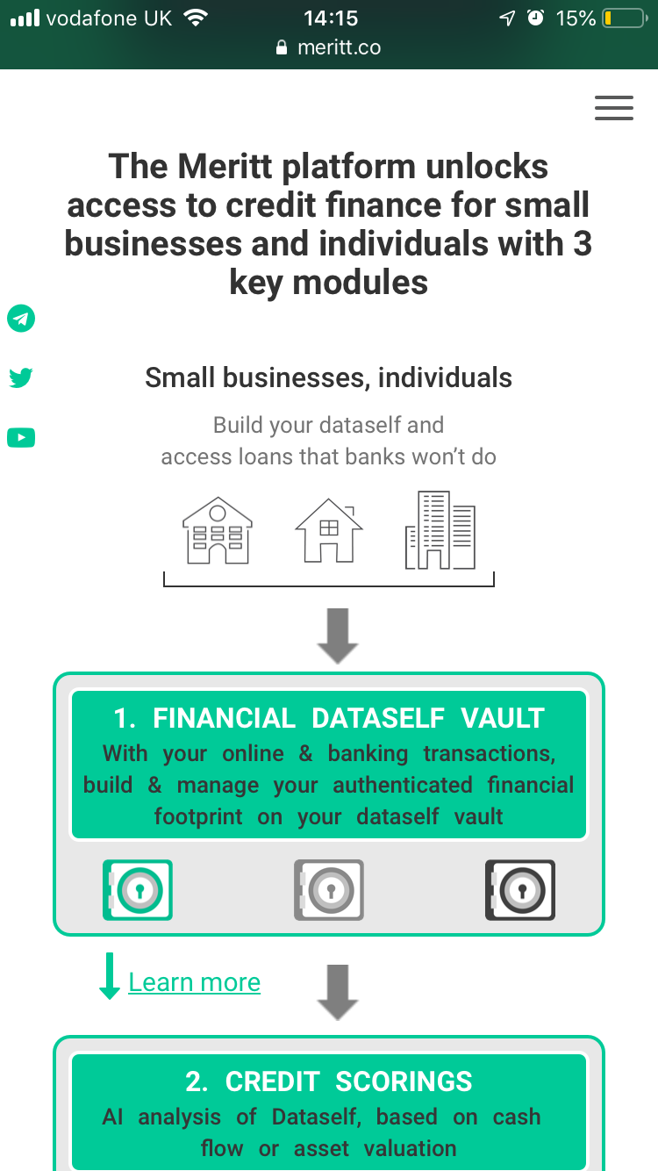









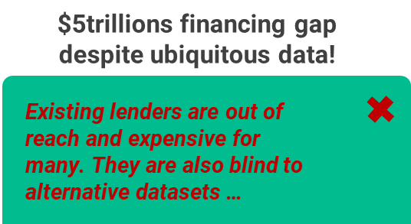
Existing
Revised
Meritt is a direct lending platform enabling individuals & businesses to harness their everyday data to have better access to finance
Low cost & Automated
New
addition
Instant & easy
Compliant
  Transparent
Local platforms
Consent based
Safe & secure
Bespoke
Thin file scoring

Slide 5
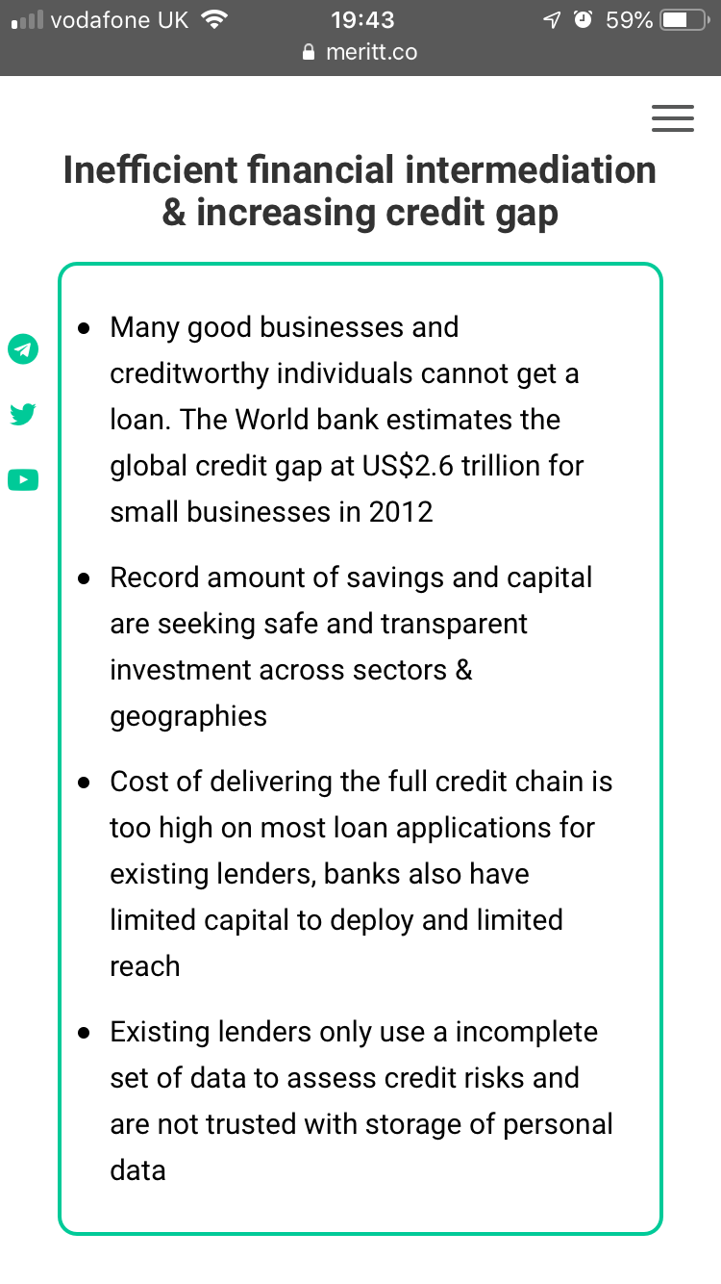

Existing
Revised
$5trillions financing gap
despite ubiquitous data!
Existing lenders are out of reach and expensive for many. They are also blind to alternative datasets …
Institutional lenders
Retail investors
Data
PORTRAIT
MOBILE
All
In
One
screen
Risks
Admin
Compliance
Individuals
Businesses
…resulting in missed opportunities for investors and for creditworthy individuals and businesses

Slide 6
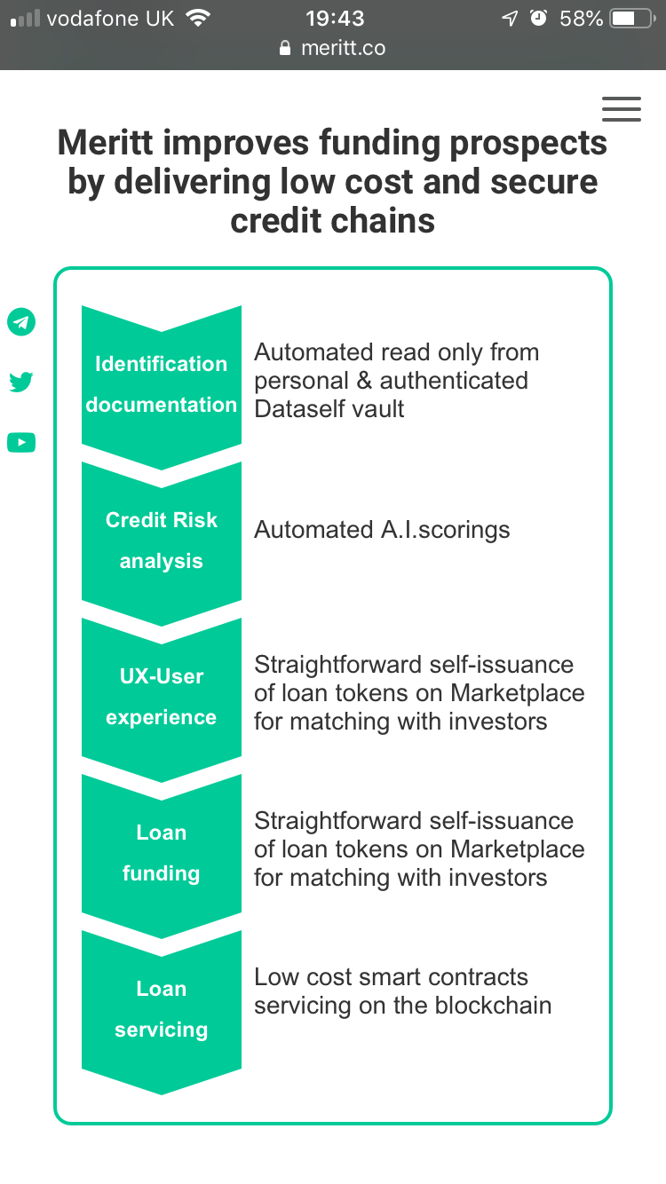

Existing
Revised
Investors on Meritt access
superior risk adjusted returns with
end-to-end digital lending channels that are secure and low cost
Identification, KYC documentation
Automated
read from
encrypted
Dataself
PORTRAIT
MOBILE
Credit Risk analysis
Underwriting
All
In
One
screen
Automated
A.I. credit Scorings
UX - User experience
Straightforward self-issuance of loan tokens for matching with investors on Marketplace
Loan
funding
Loan
servicing
Low cost & transparent
smart contracts servicing on the Meritt blockchain

Slide 7

Existing
Revised
The Meritt direct lending platform has 3 key technology stacks
Businesses, Individuals
  1. BIGDATASELF
Free service to build & manage own
digital footprint on unique encrypted private repository. Support any structured data such as banking, mobile and online transactions.
Learn more
  2. A.I. CREDIT SCORINGS
Models trained with Machine
Learning algorithms using Bigdataselfs and other public and private data (e.g. PSD2) for continuous automated underwriting.
Learn more
Learn more
  3. BLOCKCHAIN SERVICING
  & MARKETPLACE
Simple self-issuance of authenticated
loan tokens on marketplace for requesting finance. Automated & low cost smart contract servicing on matching with investors.
Learn more
Investors, Lenders

Slide 8
Businesses, Individuals
Revised
  1. BIGDATASELF
Free service to build & manage own
digital footprint on unique encrypted private repository. Support any structured data such as banking, mobile and online transactions.
Learn more
  2. A.I. CREDIT SCORINGS
All
In
One
screen
Models trained with Machine
Learning algorithms using Bigdataselfs and other public and private data (e.g. PSD2) for continuous automated underwriting.
Learn more
Learn more
  3. BLOCKCHAIN SERVICING
  & MARKETPLACE
Simple self-issuance of authenticated
loan tokens on marketplace for requesting finance. Automated & low cost smart contract servicing on matching with investors.
Learn more
Investors, Lenders

Slide 9
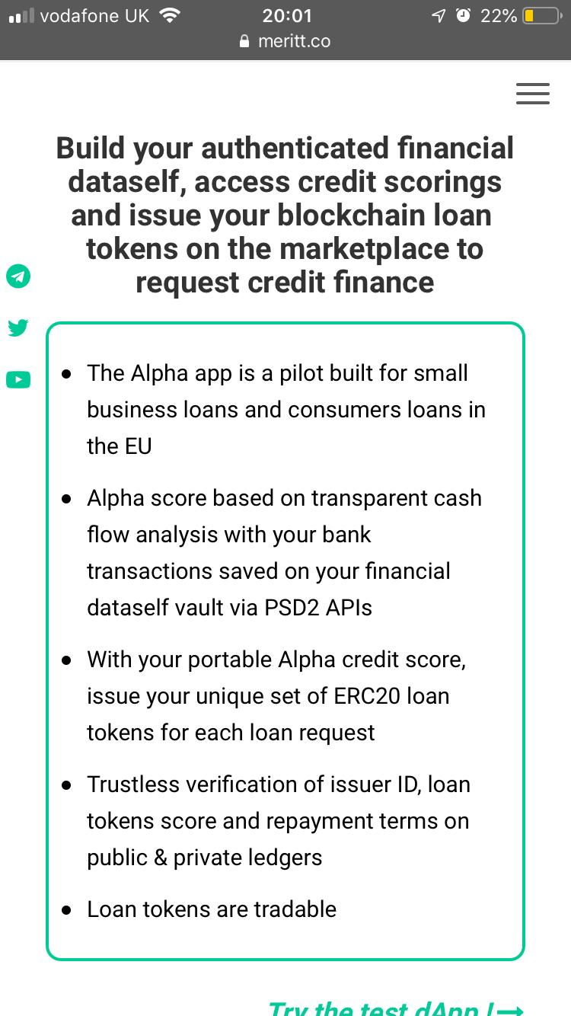
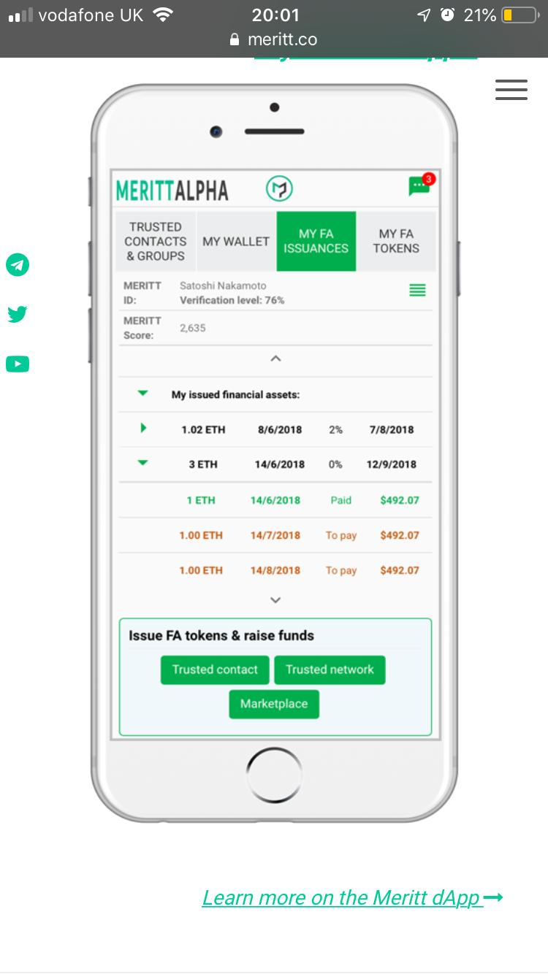
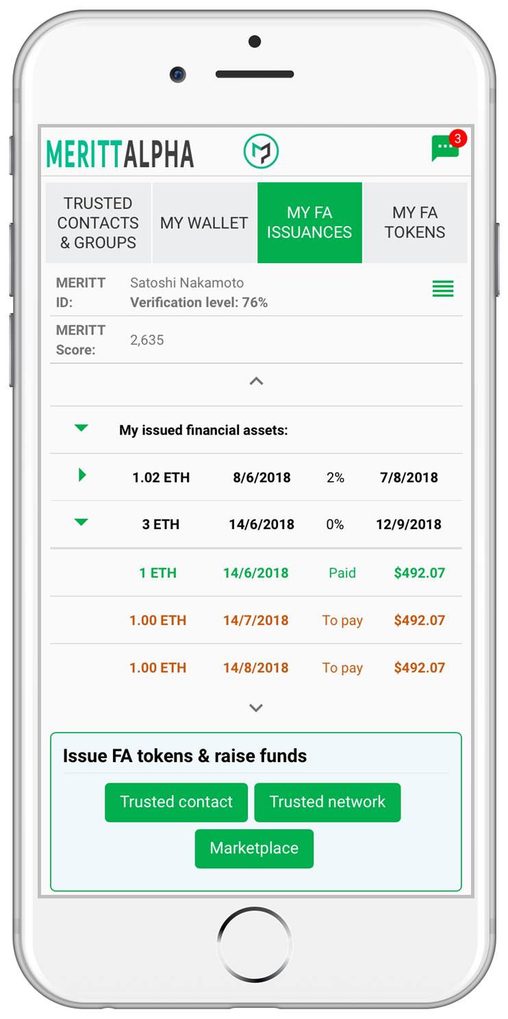
Existing
Revised
Try the mobile application pilot on the test network !
Businesses, Individuals
To request unsecured loans:
Build your Bigdataself
Request credit scorings
Issue your authenticated blockchain loan tokens on the marketplace
All
In
One
screen
Investors, Lenders
To invest and lend :
Select your risk/return profile & geography
Select individual or portfolios loan tokens
Liquid secondary market with tradable loan tokens
Learn more on the Meritt dApp

Slide 10
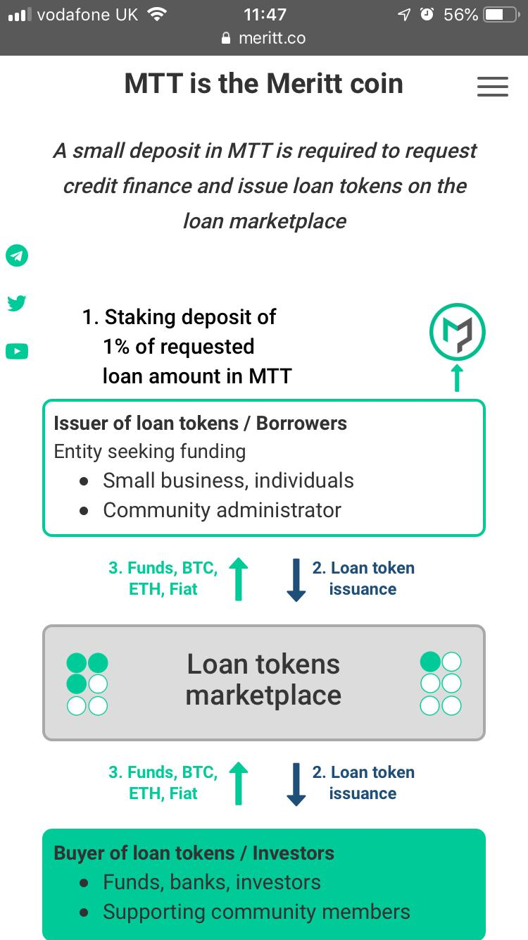
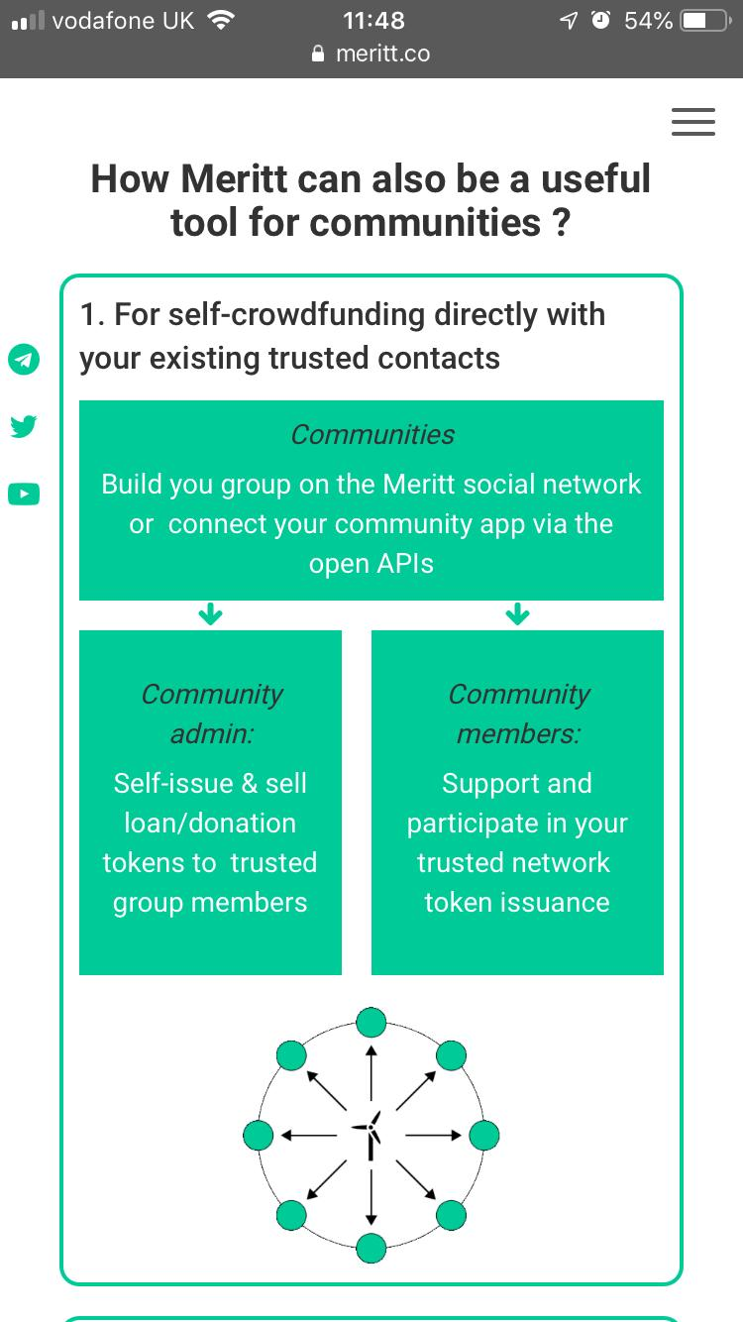
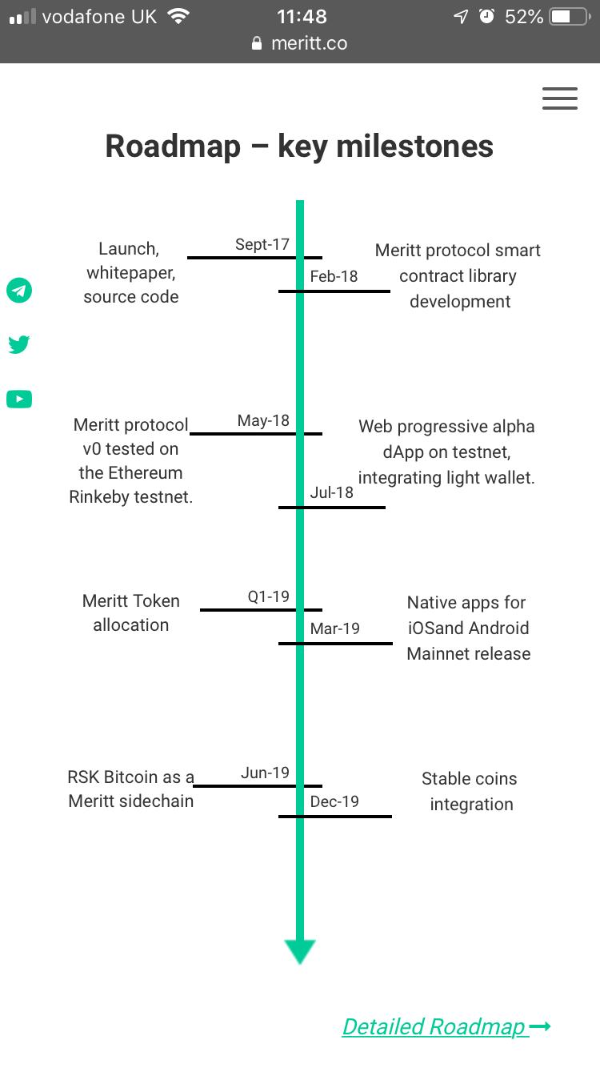
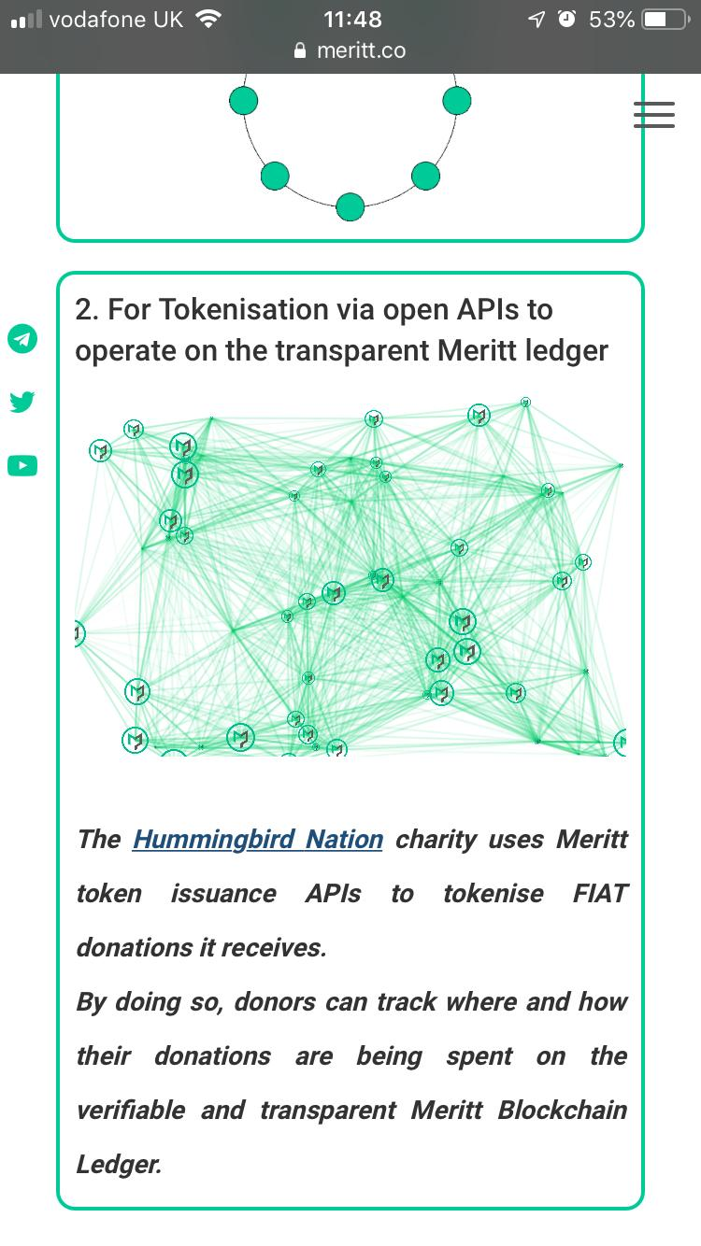
The remaining pages on Portrait mobile are the same except for the text changes that you find in the desktop website document v3.0
Page into new separate section
www.meritt.co/mtt
Same but text changes
Same but text changes
Same but text changes

Slide 11
LANDSCAPE
MOBILE

Slide 12
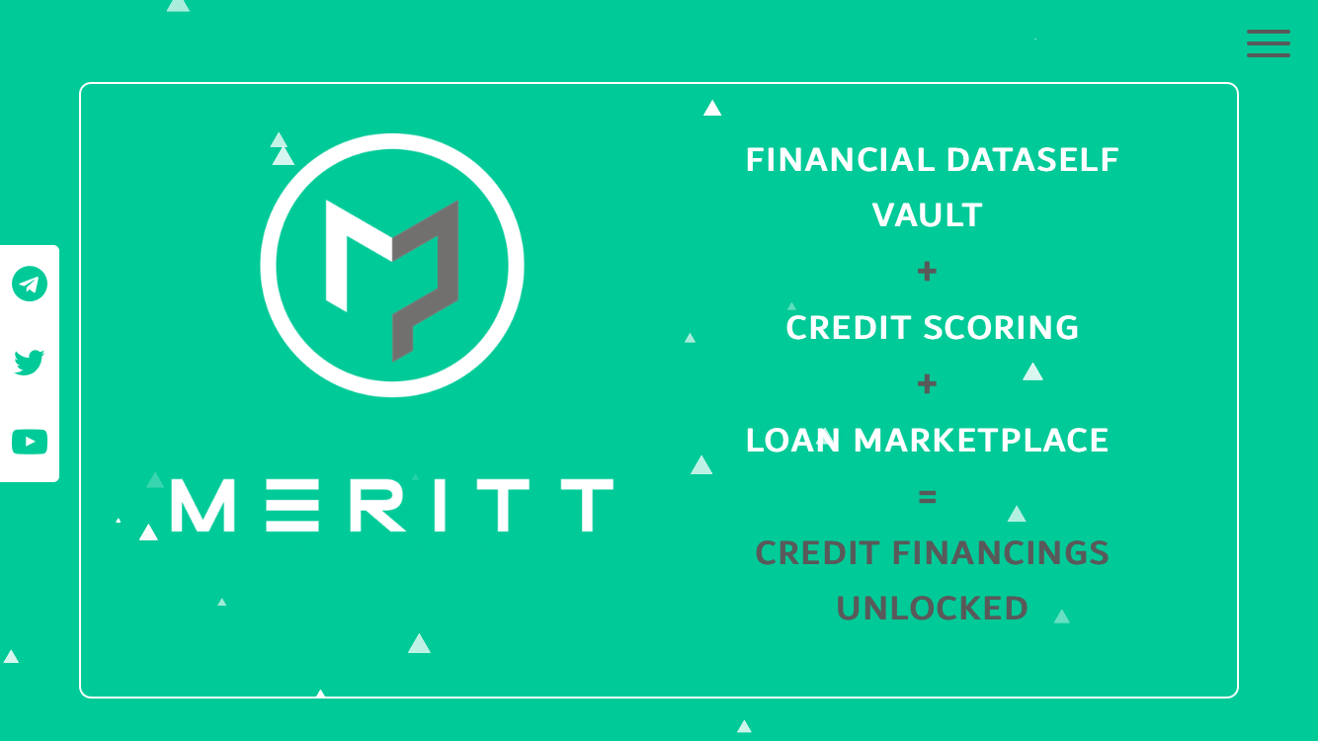
LANDSCAPE
MOBILE
Revised
Existing
ACCESS INSTANT UNSECURED LOANS¹
INVEST at
SUPERIOR RETURNS²
DIRECT LENDING PLATFORM
BIGDATASELF | A.I. SCORINGS | BLOCKCHAIN SERVICING
1:Borrow responsibly
2:Capital at risk
Login or join our whitelist

Slide 13
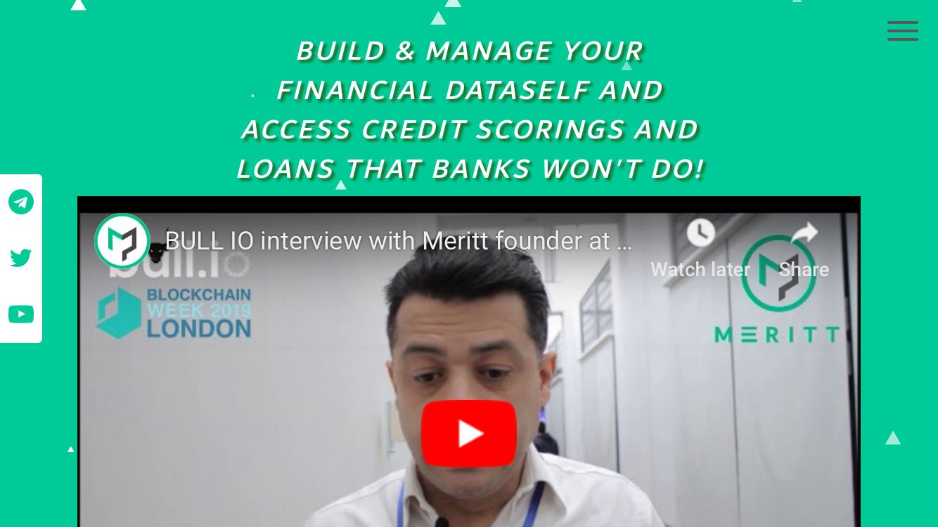
Revised
“BUILD & MANAGE YOUR
BIGDATASELF AND
ACCESS CREDIT SCORINGS AND LOANS THAT BANKS WON’T DO!”
Existing

Slide 14
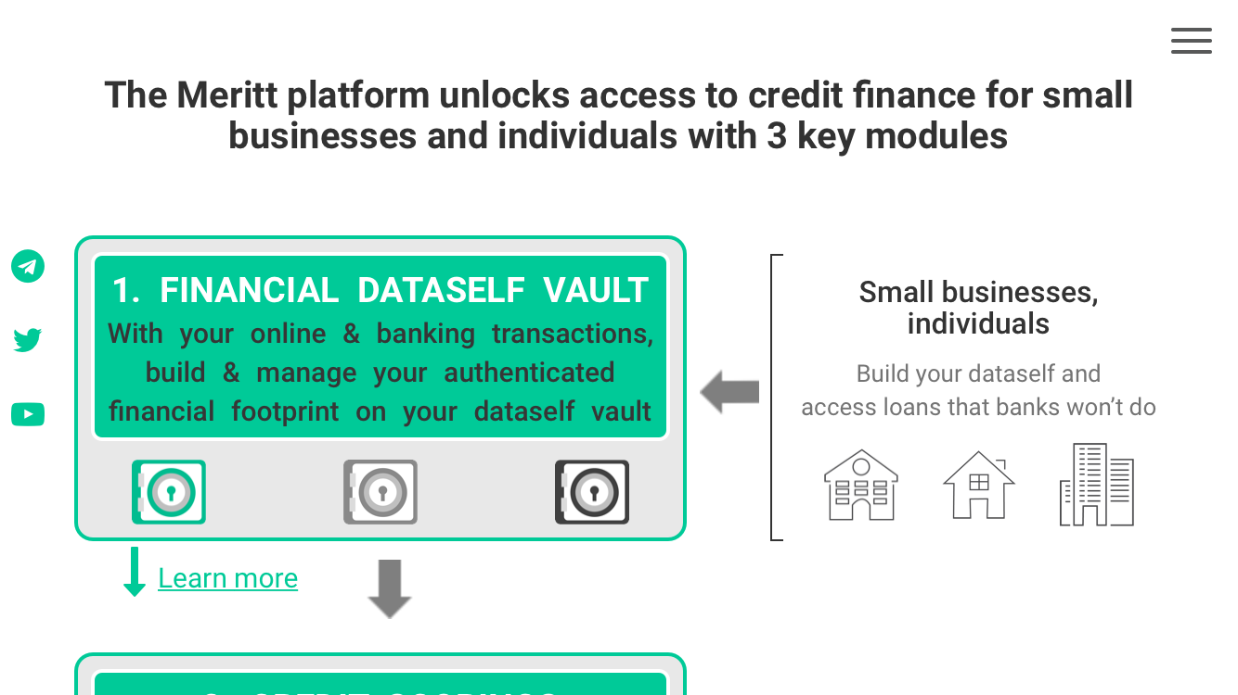

New section here
Meritt is a direct lending platform enabling
individuals & businesses to harness their everyday data
to have better access to finance
Existing
LANDSCAPE
MOBILE
New section
Instant & easy
Low cost & Automated
Compliant
Local platforms
Safe & secure
  Transparent
Bespoke
Consent based
Thin file scoring

Slide 15
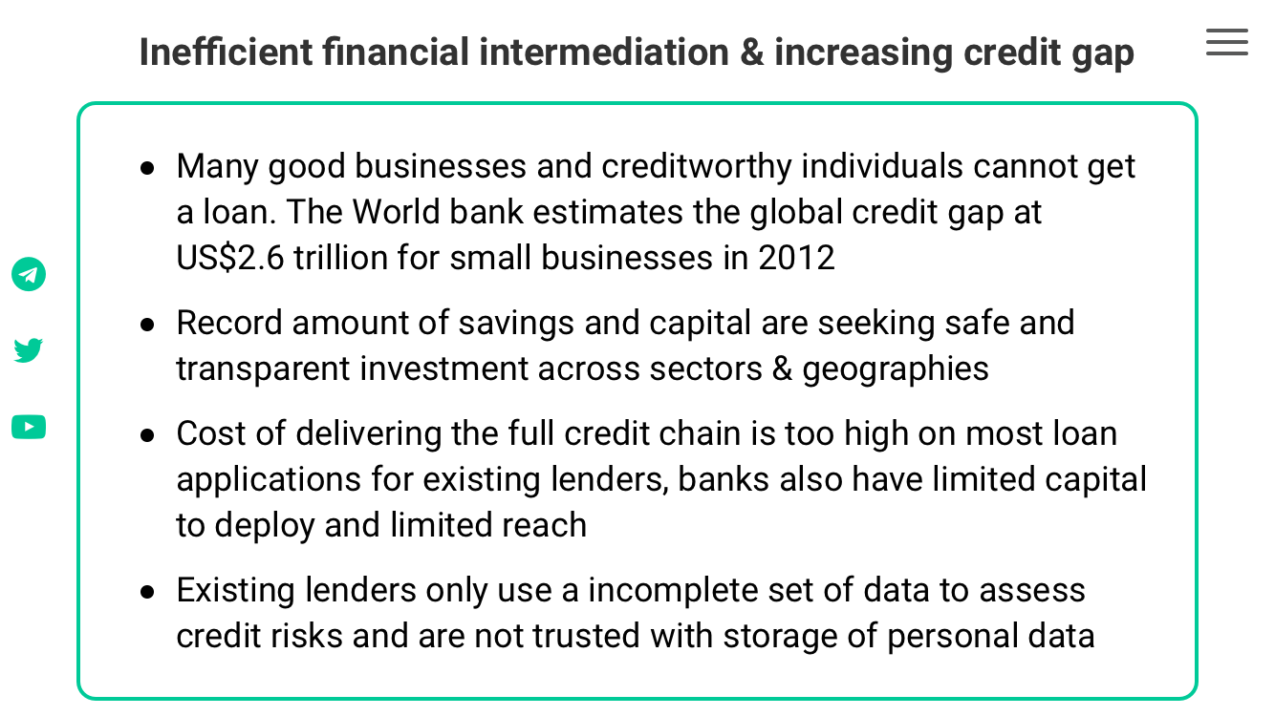
Revised
$5 trillion financing gap despite ubiquitous data!
Existing
Existing lenders are out of reach and expensive for many. They are also blind to alternative datasets …
LANDSCAPE
MOBILE
Individuals, Businesses
Compliance
Admin
Institutional lenders
Investors
Risks
Data
…resulting in missed opportunities for investors and for creditworthy individuals and businesses

Slide 16
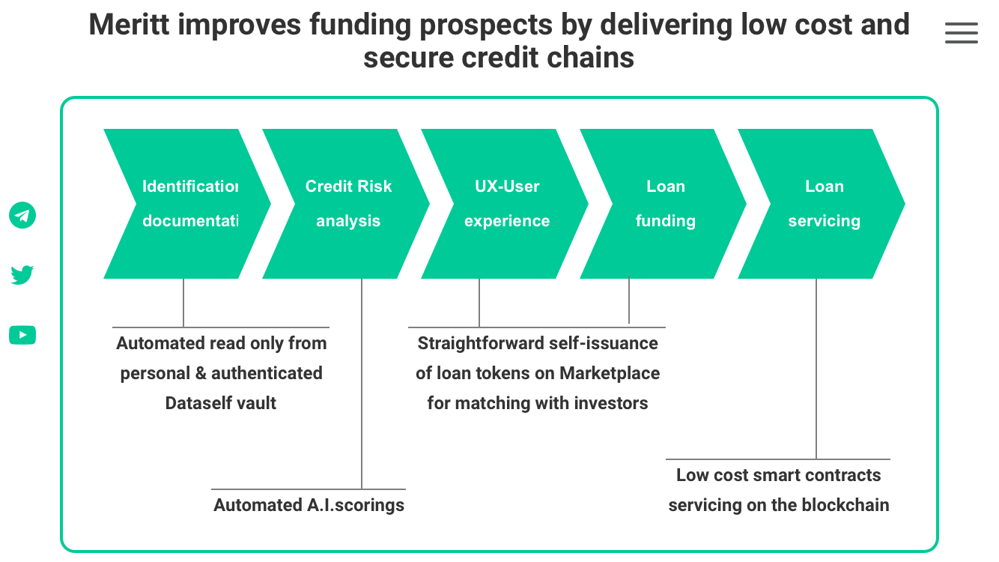

Revised
Investors on Meritt access superior risk adjusted returns with end-to-end digital lending channels that are secure and low cost
Existing
LANDSCAPE
MOBILE
Identification
KYC
documentation
Credit Risk analysis
Underwriting
UX - User experience
Loan funding
Loan servicing
All
In
One
screen
Automated
read from
encrypted
Dataself
Automated
A.I. credit Scorings
Straightforward self-issuance of loan tokens for matching with investors on Marketplace
Low cost &
transparent smart-contracts servicing on the Meritt blockchain

Slide 17
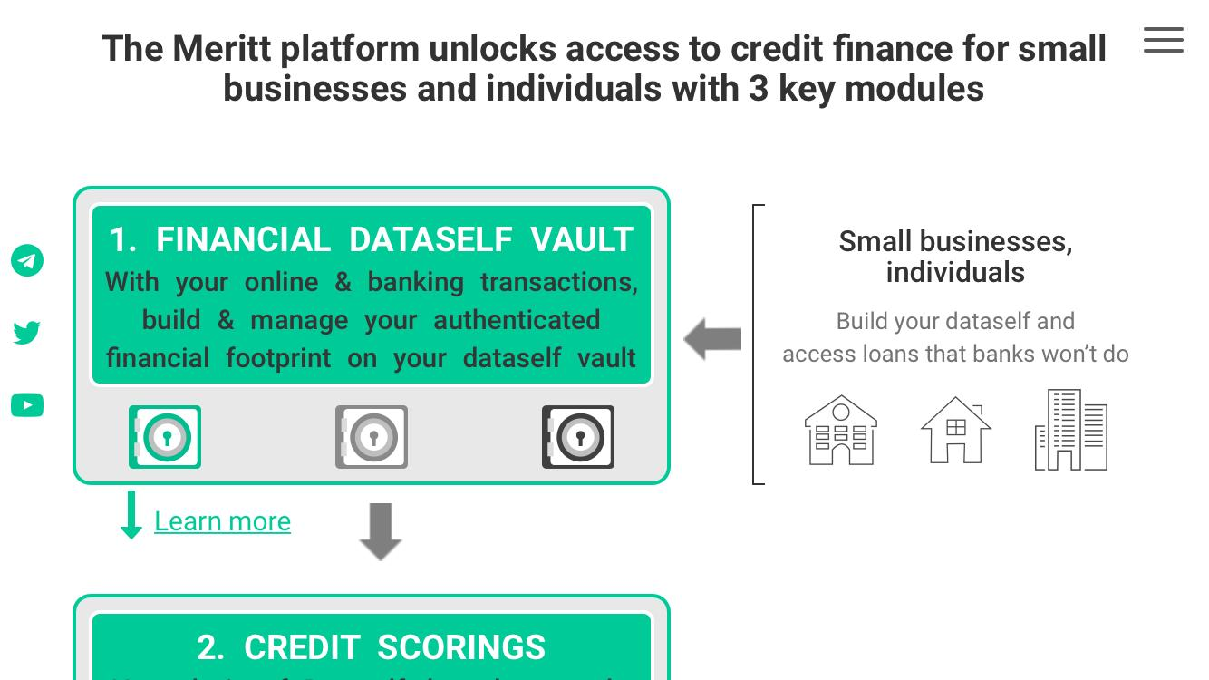
Revised
The Meritt direct lending platform has 3 key technology stacks
Existing
LANDSCAPE
MOBILE
Businesses, Individuals
  1. BIGDATASELF
Free service to build & manage own
digital footprint on unique encrypted private repository. Support any structured data such as banking, mobile and online transactions.
Learn more
  2. A.I. CREDIT SCORINGS
Models trained with Machine
Learning algorithms using Bigdataselfs and other public and private data (e.g. PSD2) for continuous automated underwriting.

Slide 18
Businesses, Individuals
  1. BIGDATASELF
LANDSCAPE
MOBILE
Free service to build & manage own
digital footprint on unique encrypted private repository. Support any structured data such as banking, mobile and online transactions.
Learn more
  2. A.I. CREDIT SCORINGS
Models trained with Machine
Learning algorithms using Bigdataselfs and other public and private data (e.g. PSD2) for continuous automated underwriting.
Learn more
Learn more
  3. BLOCKCHAIN SERVICING
  & MARKETPLACE
Simple self-issuance of authenticated
loan tokens on marketplace for requesting finance. Automated & low cost smart contract servicing on matching with investors.
Investors, Lenders
Learn more

Slide 19
Learn more
  2. A.I. CREDIT SCORINGS
LANDSCAPE
MOBILE
Models trained with Machine
Learning algorithms using Bigdataselfs and other public and private data (e.g. PSD2) for continuous automated underwriting.
Learn more
2 blocks per screen
Learn more
  3. BLOCKCHAIN SERVICING
  & MARKETPLACE
Simple self-issuance of authenticated
loan tokens on marketplace for requesting finance. Automated & low cost smart contract servicing on matching with investors.
Investors, Lenders
Learn more

Slide 20
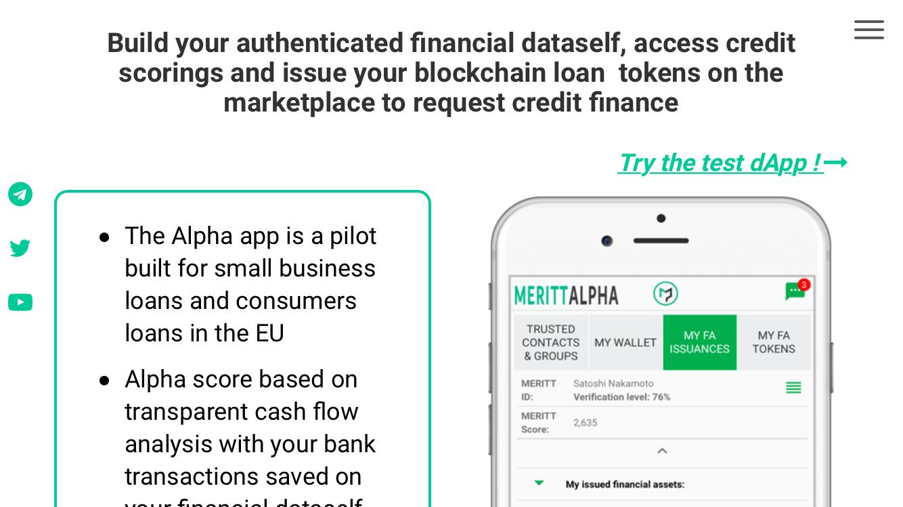
Revised
Try the mobile application pilot on the test network !
Existing
LANDSCAPE
MOBILE
Businesses, Individuals
To request unsecured loans:
Build your Bigdataself
Request credit scorings
Issue your authenticated blockchain loan tokens on the marketplace
Investors, Lenders
To invest and lend :
Select your risk/return profile & geography
Select individual or portfolios loan tokens
Liquid secondary market with tradable loan tokens
All
In
One
screen
Learn more on the Meritt dApp

Slide 21
The remaining pages on Landscape mobile are the same except for the text changes that you find in the desktop website document v3.0
Meritt coin page under Page into new separate section
www.meritt.co/mtt

